Slide 1

Digital Image processing, Spring 2022
Northwestern Polytecnical University
2019380141 – ABID ALI

Slide 2
Introduction
Canny Edge Algorithm
The purpose of edge detection in general is to significantly reduce the amount of data in an image, while preserving the structural properties to be used for further image processing. Several algorithms exists, and this today we focuses on a particular one developed by John F. Canny (JFC) in 1986.Canny has found that the requirements for the application of edge detection on diverse vision systems are relatively similar.

Slide 3
Aim of Canny Edge Algorithm
The aim of JFC was to develop an algorithm that is optimal with regards to the following criteria:
Detection: The probability of detecting real edge points should be maximized while the probability of falsely detecting non-edge points should be minimized. This corresponds to maximizing the signal-to-noise ratio.
Localization: The detected edges should be as close as possible to the real edges.
Number of responses: One real edge should not result in more than one detected edge

Slide 4
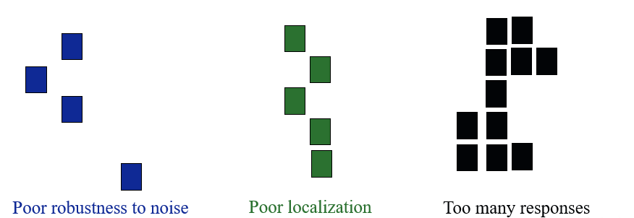
Quality of an Edge Detector
Robustness to Noise
Localization
Too Many/Too less Responses
True Edge

Slide 5
The Process Canny Edge Detection Algorithm
The process of Canny edge detection algorithm can be broken down to five different steps:
Smoothing(Gaussian filter): Blurring of the image to remove noise.
Finding gradients: The edges should be marked where the gradients of the image has large magnitudes.
Non-maximum suppression: Only local maxima should be marked as edges.
Double thresholding: Potential edges are determined by thresholding.
Edge tracking by hysteresis: Final edges are determined by suppressing all edges that are not connected to a very certain (strong) edge.

Slide 6
Smoothing(Gaussian filter)
It is inevitable that all images taken from a camera will contain some amount of noise. To prevent that noise is mistaken for edges, noise must be reduced. Therefore the image is first smoothed by applying a Gaussian filter
Smooth by Gaussian
(a) Original
(b) Smoothed

Slide 7
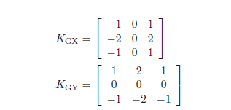

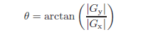
Finding gradients
The Canny algorithm basically finds edges where the grayscale intensity of the image changes the most. These areas are found by determining gradients of the image. Gradients at each pixel in the smoothed image are determined by applying what is known as the Sobel-operator.
First step is to approximate the gradient in the x- and y-direction respectively by applying the kernels shown in equation
The Euclidean distance measure has been applied to the test image. The computed edge strengths are compared to the smoothed image
Gx and Gy are the gradients in the x- and y-directions respectively.
However, the edges are typically broad and thus do not indicate exactly where the edges are. To make it possible to the direction of the edges must be determined and stored as

Slide 8
Gradient (Cont.)
(a) Smoothed b) Gradient magnitudes
The gradient magnitudes in the smoothed image showed as well as their directions are determined by applying e.g. the Sobel-operator.

Slide 9
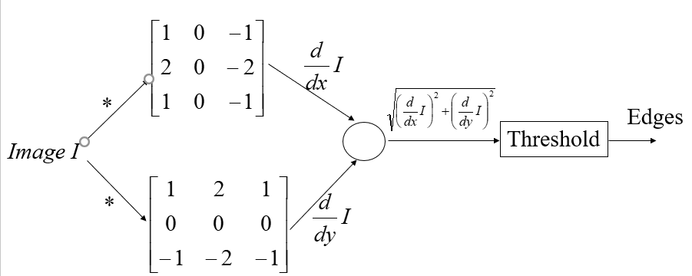
Detecting Edges in Image
Sobel Edge Detector

Slide 10
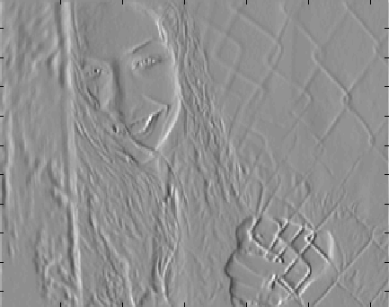
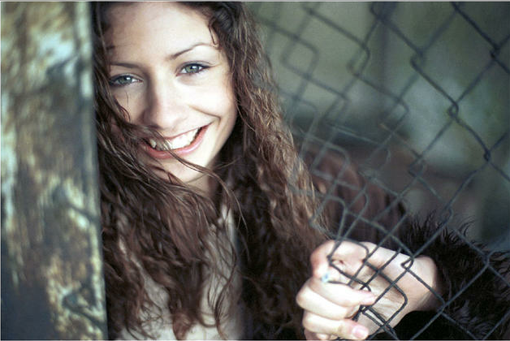
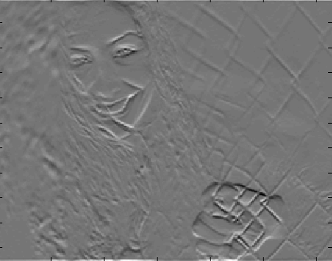
Detecting Edges in Image
Sobel Edge Detector
Original Image

Slide 11
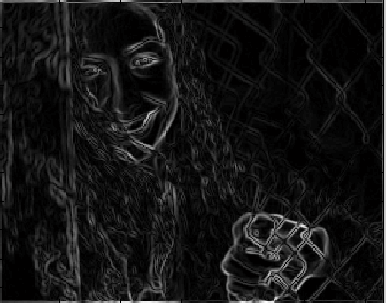
Detecting Edges in Image
Sobel Edge Detector
Gradient
Original Image

Slide 12
Non-maximum suppression
The purpose of this step is to convert the “blurred” edges in the image of the gradient magnitudes to “sharp” edges. Basically this is done by preserving all local maxima in the gradient image, and deleting everything else. The algorithm is for each pixel in the gradient image:
1. Round the gradient direction to nearest 45◦, corresponding to the use of an 8-connected neighborhood.
2. Compare the edge strength of the current pixel with the edge strength of the pixel in the positive and negative gradient direction. (i.e) if the gradient direction is north (theta =90◦), compare with the pixels to the north and south.
3. If the edge strength of the current pixel is largest; preserve the value of the edge strength. If not, suppress (i.e. remove) the value.

Slide 13
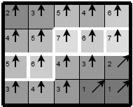
Non-maximum suppression(Cont.)
A simple example of non-maximum suppression is shown in Figure . Almost all pixels have gradient directions pointing north. They are therefore compared with the pixels above and below. The pixels that turn out to be maximal in this comparison are marked with white borders. All other pixels will be suppressed.
Illustration of non-maximum suppression. The edge strengths are indicated both as colors and numbers, while the gradient directions are shown as arrows. The resulting edge pixels are marked with white borders.
a) Gradient values (b) Edges after non-maximum suppression

Slide 14
Double thresholding
The edge-pixels remaining after the non-maximum suppression step are (still) marked with their strength pixel-by-pixel. Many of these will probably be true edges in the image, but some may be caused by noise or color variations for instance due to rough surfaces. The simplest way to discern between these would be to use a threshold, so that only edges stronger that a certain value would be preserved. The Canny edge detection algorithm uses double thresholding. Edge pixels stronger than the high threshold are marked as strong; edge pixels weaker than the low threshold are suppressed and edge pixels between the two thresholds are marked as weak.
(a) Edges after non-maximum suppression (b) Double thresholding
In the second image strong edges are white, while weak edges are grey. Edges with a strength below both thresholds are suppressed.

Slide 15
Edge tracking by hysteresis
Strong edges are interpreted as “certain edges”, and can immediately be included in the final edge image. Weak edges are included if and only if they are connected to strong edges. The logic is of course that noise and other small variations are unlikely to result in a strong edge(with proper adjustment of the threshold levels). Thus strong edges will (almost) only be due to true edges in the original image.
a) Double thresholding (b) Edge tracking by hysteresis (c) Final output
Edge tracking and final output. The middle image shows strong edges in white, weak edges connected to strong edges in blue, and other weak edges in red.

Slide 16
Summary
1. The (source) image and the thresholds can be chosen arbitrarily.
2. Only a smoothing filter with a standard deviation of = 1.4 was used(the one shown in Equation 1).
3. The implementation uses the “correct” Euclidean measure for the edge strengths.
4. The different filters cannot be applied to edge pixels. This causes the output image to be 8 pixels smaller in each direction.
The last step in the algorithm known as edge tracking can be implemented as either iterative or recursive BLOB analysis where only BLOB’s containing strong edges are preserved.
However, our implementation uses the iterative approach. First all weak edges are scanned for neighbor edges and joined into groups. At the same time it is marked which groups are adjacent. Then all of these markings are examined to determine which groups of weak edges are connected to strong edges (directly or indirectly). All weak edges that are connected to strong edges are marked as strong edges themselves. The rest of the weak edges are suppressed.

Slide 17
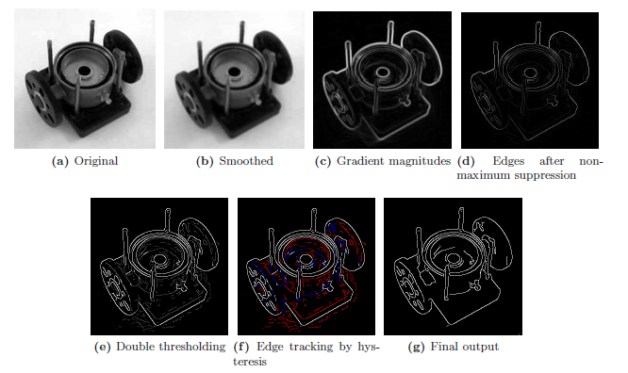
Summary(Cont.)
All steps of the edge detection

Slide 18
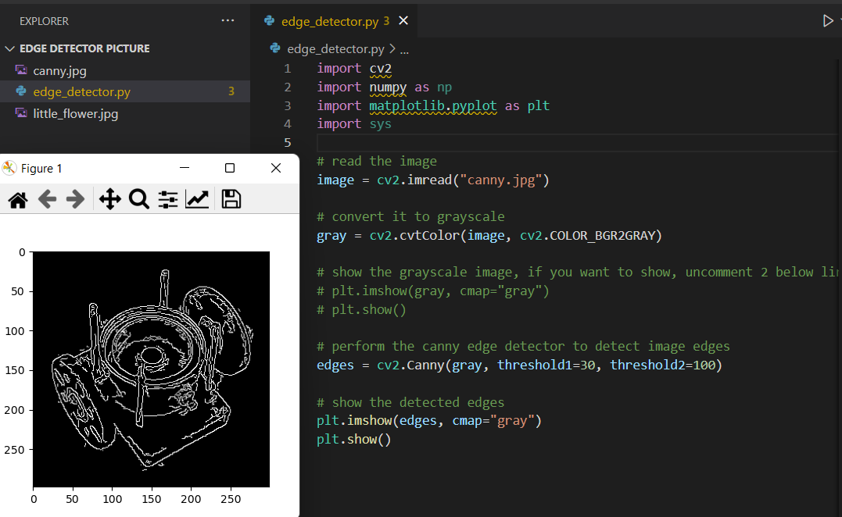
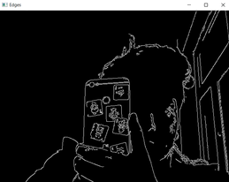
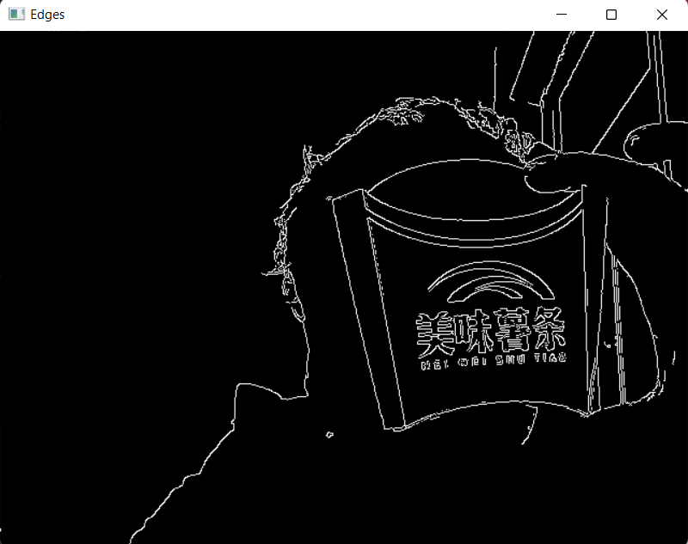
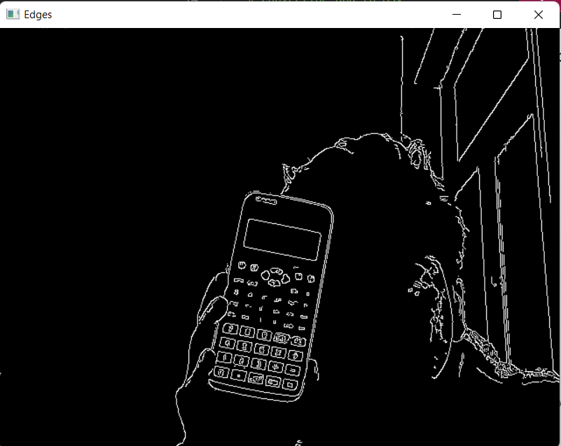
EXTRA(Pictures)

Slide 19
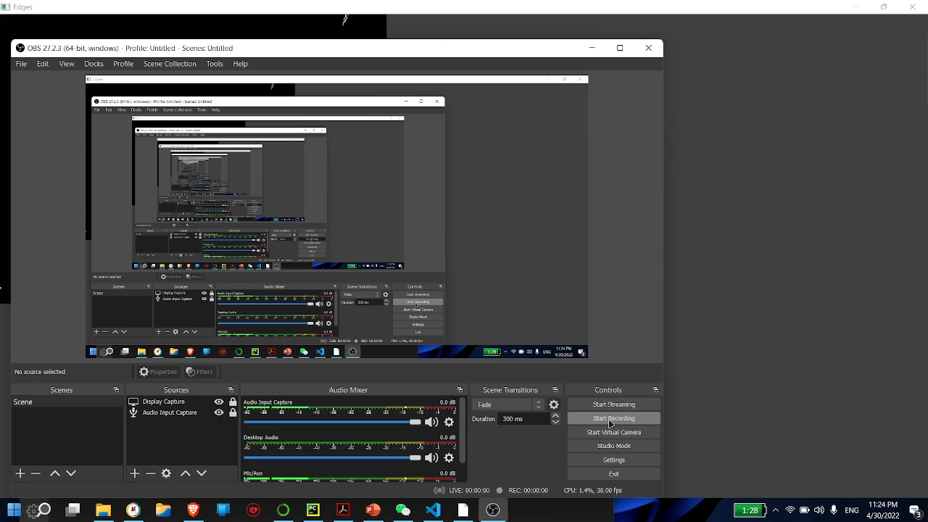
EXTRA(Pictures)

Slide 20

The Canny edge detector is an edge detection operator that uses a multi-stage algorithm to detect a wide range of edges in images. . As canny edge detector is becoming more widely used in digital image processing there are some issues that need to be resolved. A large variety of different techniques with their own advantages and disadvantages are present. Many of them used techniques are not robust enough to detect efficiently.
Conclusion
Thank You!!

